Slide 1
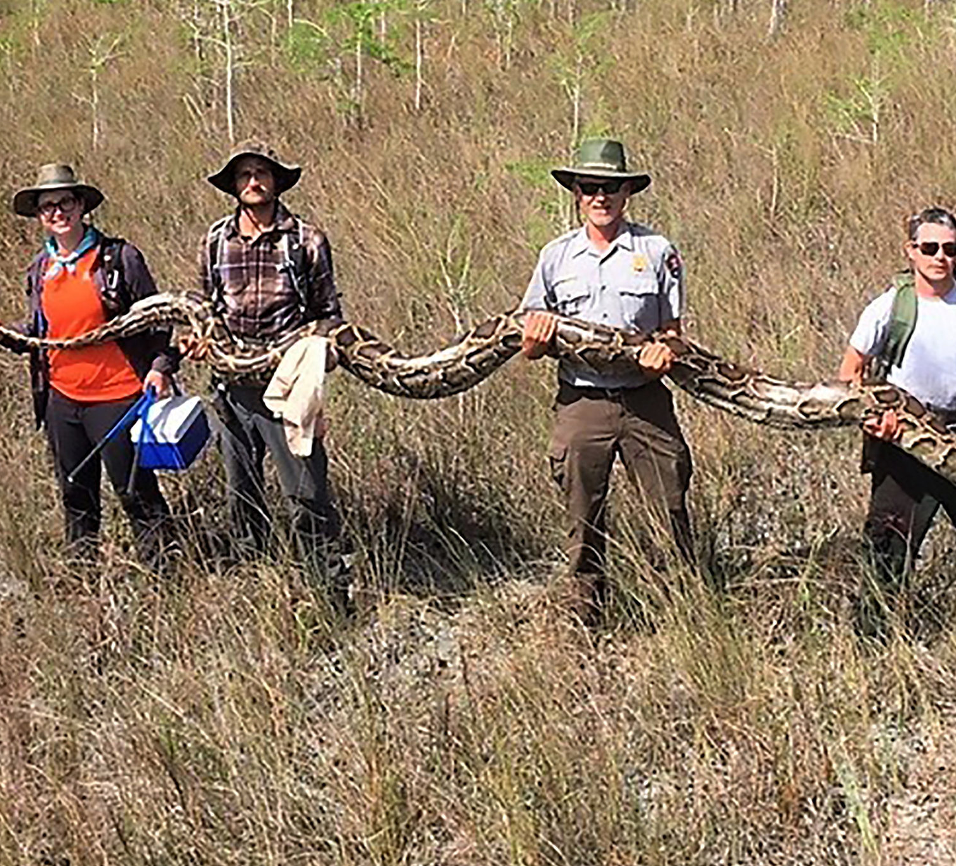
Burmese Python Detection in the Everglades
Gianluca Mangiapane
Presentation 1
MUSA Capstone Spring 2022

Slide 2
What is the Problem?
Burmese Pythons are an invasive species to Southern Florida, since 1979
No natural predators in southern Florida, the perfect living conditions
Elusive and naturally camouflaged, hard to detect to try and find, control, and eradicate

Slide 3
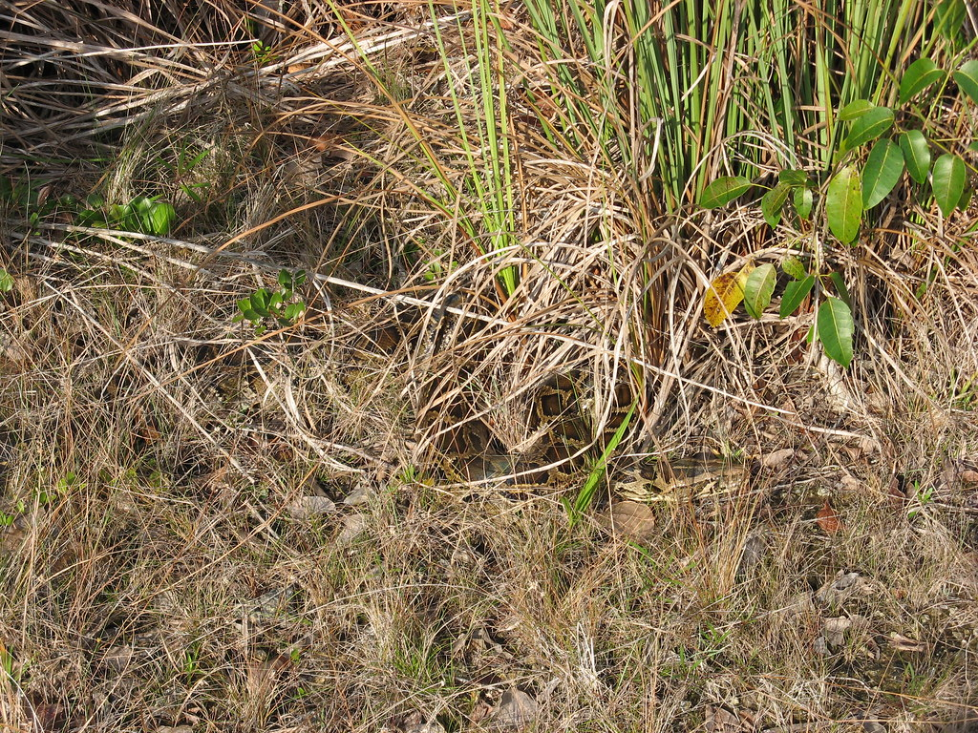

Slide 4
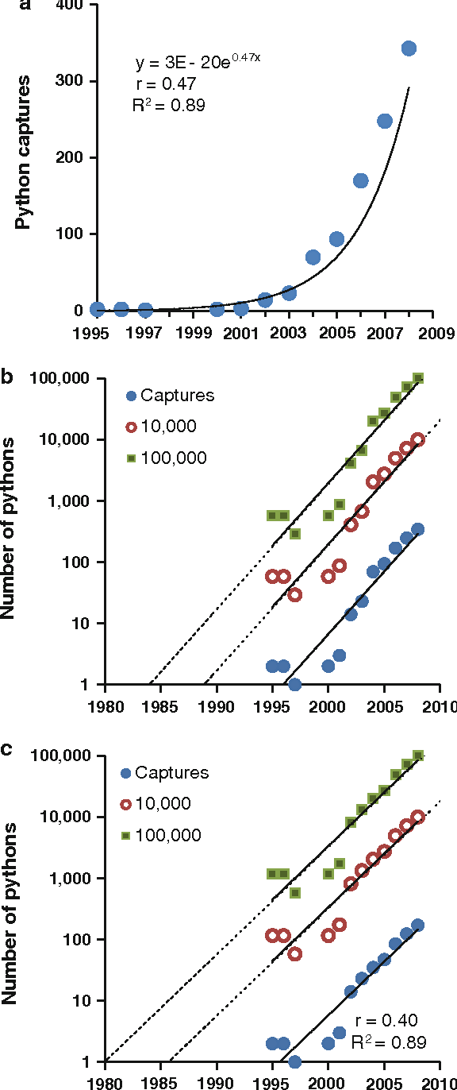
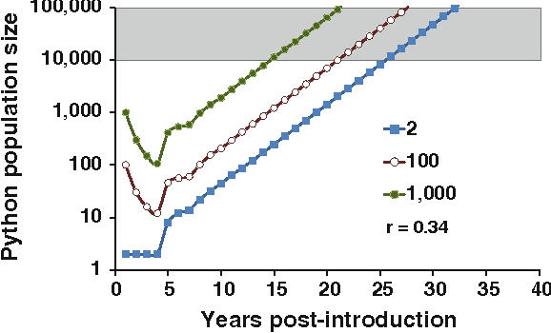
Hatchling Survival Projections
@article{Willson2010IdentifyingPS, title={Identifying plausible scenarios for the establishment of invasive Burmese pythons (Python molurus) in Southern Florida}, author={John D Willson and Michael E. Dorcas and Ray W. Snow}, journal={Biological Invasions}, year={2010}, volume={13}, pages={1493-1504} }

Slide 5
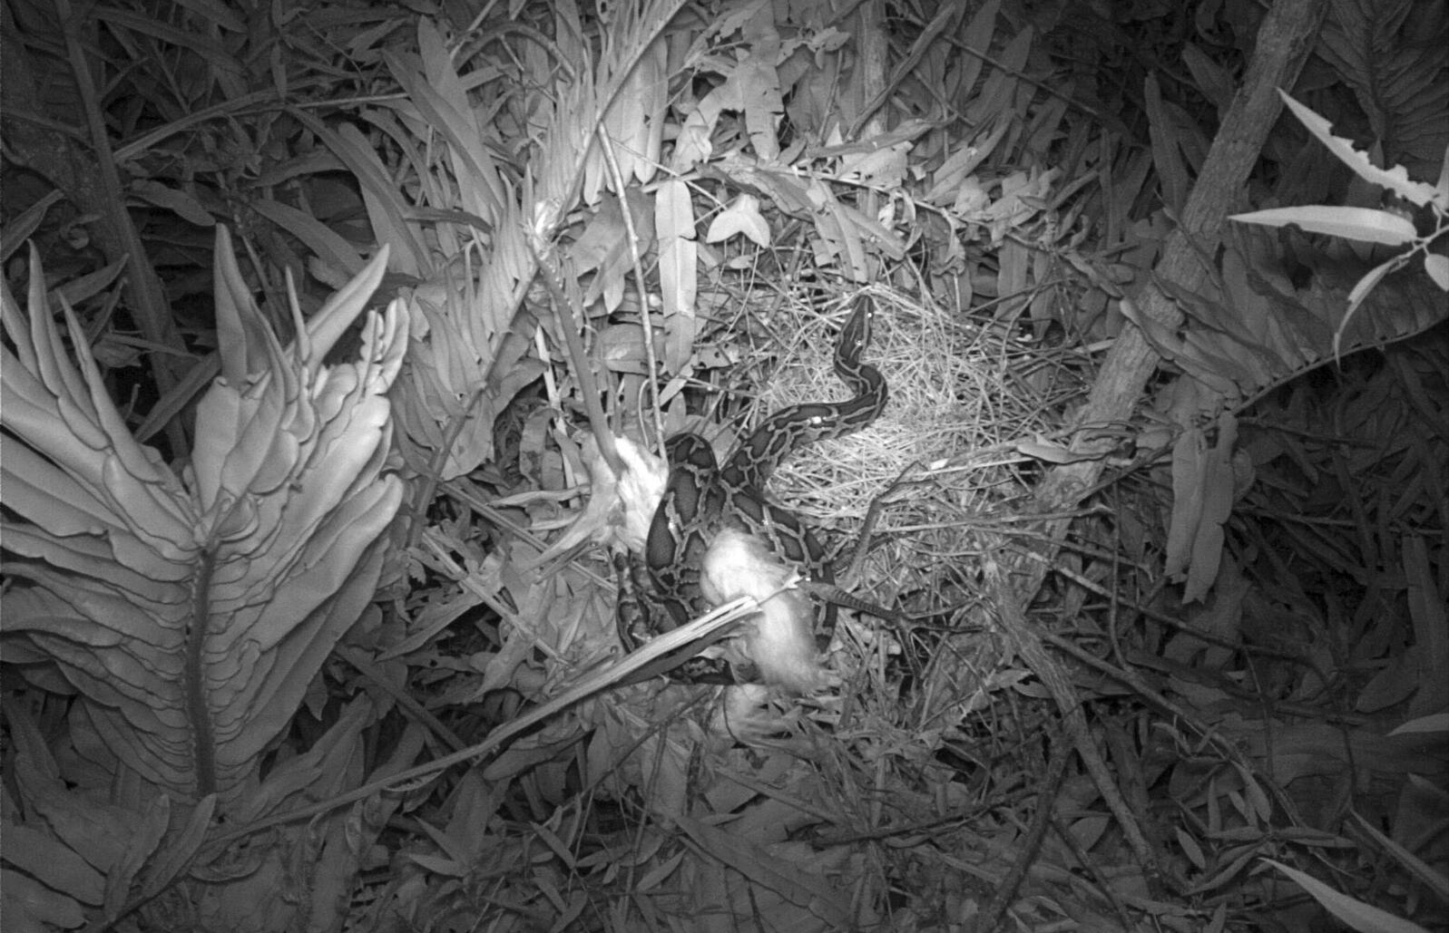
Burmese python and two Great Egret fledglings, captured on trail camera in a wading bird colony in Everglades National Park. Photo: Sophia Orzechowski
2019

Slide 6
Current Detection Methods
Detector Dogs
Remote Sensing
“Judas” snakes
Walkabouts – Camera Traps
Environmental DNA
A lot of sightings/recordings are drivers on roads as well

Slide 7
Goal: Create a Model that can help with detecting most likely presence
Are there relationships among features to help guide detection resources?

Slide 8
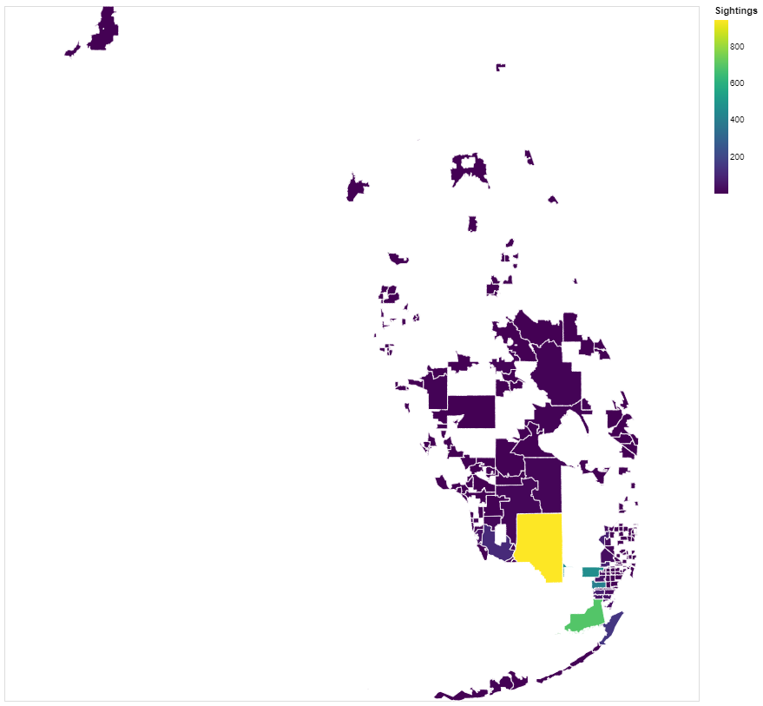
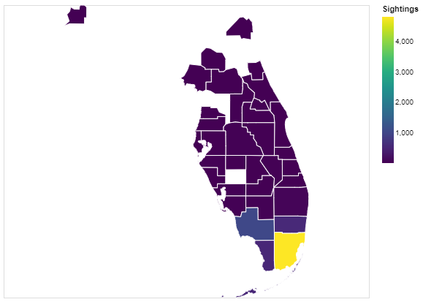

Slide 9
Datasets – aka features
Python sightings
Visual Sightings, GPS trackers, Remote Sensing
Flowing Waters and Stream sites
Lakes
Bird Habitats 2003
Designated Bird Sanctuaries
Eagle Nesting Sites
Bird Nests 2000
Land Mammal Habitation areas
Shorebird habitats
Snowy Plover Nests
Wading Bird Colonies
Urban Density Cover
Temperature/Solar Radiation in TIF format – still need to review
Environmental DNA sampling sites
Traffic Data along Florida Roads

Slide 10
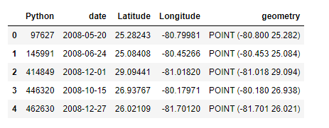
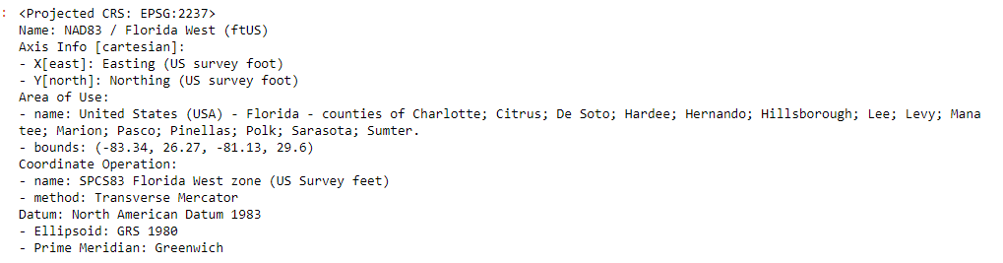
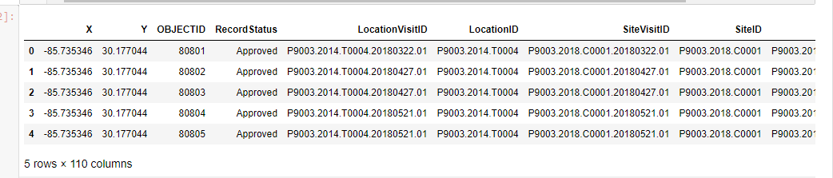
Shore Birds Example – Point vs. Point Analysis
Python Sightings
Shore Bird Habitats

Slide 11
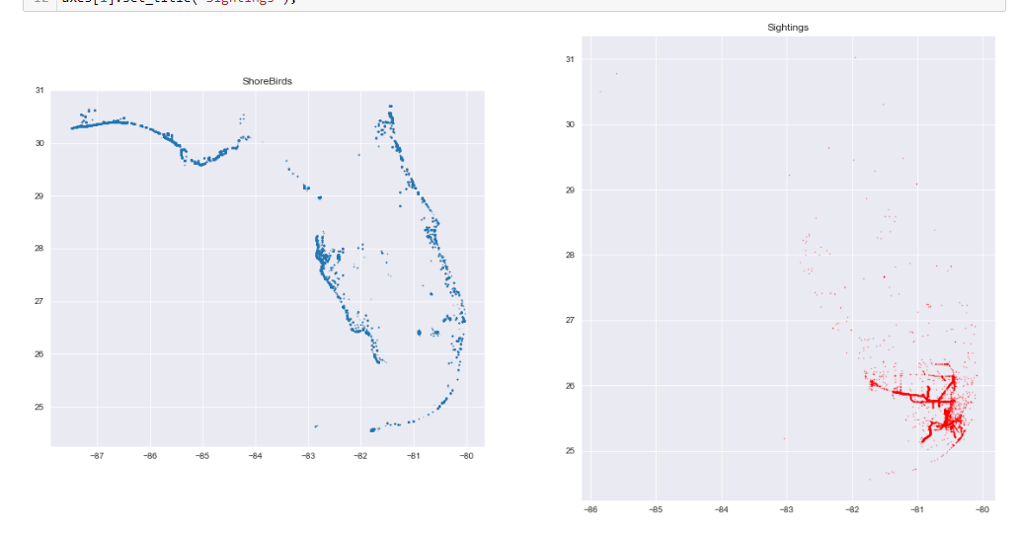
Shore Birds Example – Point vs. Point Analysis

Slide 12
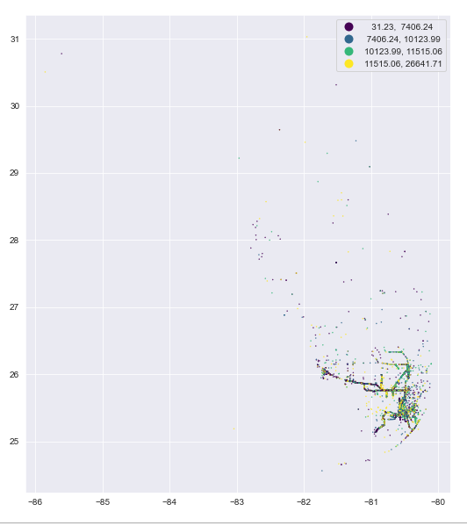
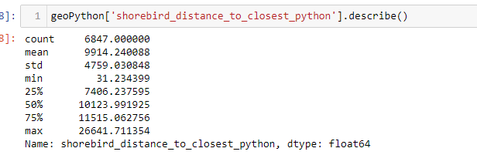
Shore Birds Example – Point vs. Point Analysis

Slide 13
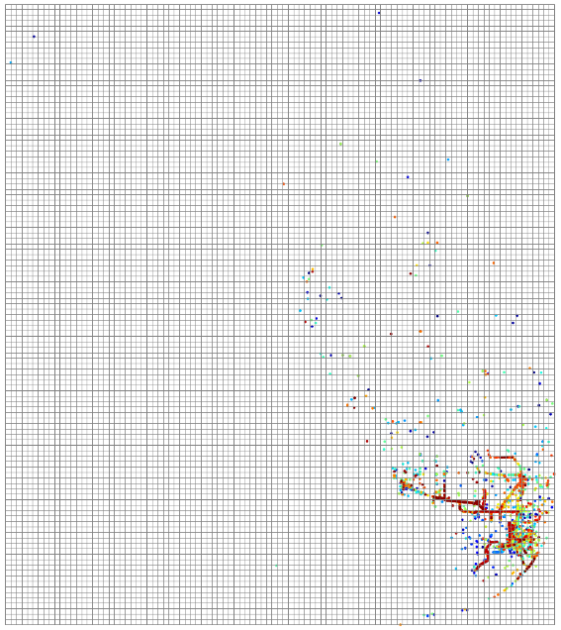

Slide 14
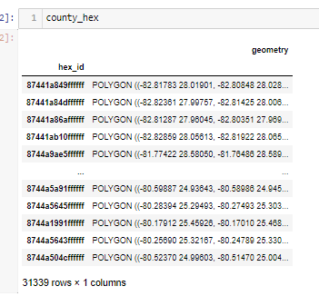
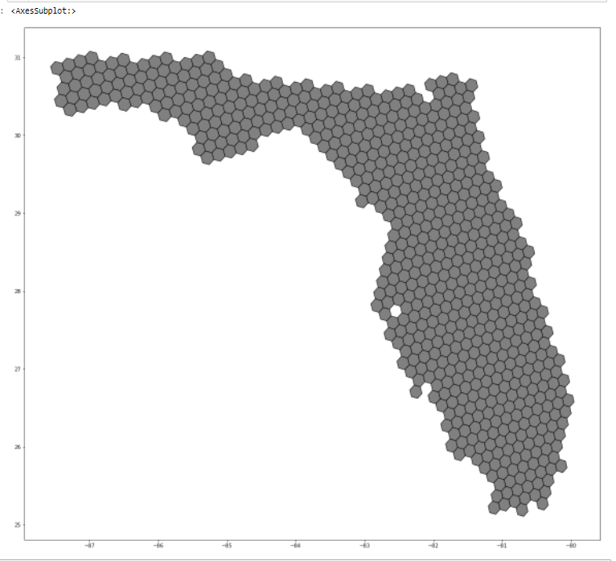
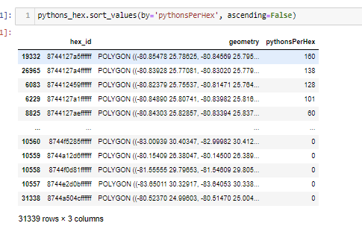
Feature Engineering
Hex Grid of Florida, resolution of 7, or 5.16129 (km²)
(eg. resolution at 5)

Slide 15
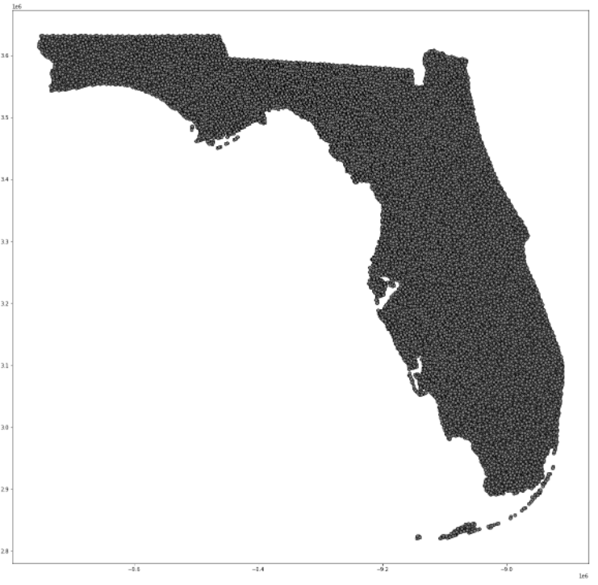
Feature Engineering
Specific Call Outs
Centroids of each Hexagon, CRS of EPSG=3857, since the distance measurement is in meters.
Min. Distance to Geometry of Prey Animal Datasets
Min distance to Urban Centers/Boundaries
Waterways Dataset
Streams, Lakes, Stormwater, Submerged Land
Traffic Data of all Florida Roads with AADT 2016-2020, min distance to roads, with HEX mean of AADT
2016 ACS Florida Counties Pop. And Med. Income, all H3 hex’s within counties were given the per hex amount

Slide 16
Multicollinearity

Slide 17
Feature Engineering
H3

Slide 18
Feature Engineering
H3

Slide 19
Feature Engineering
H3

Slide 20
Feature Engineering
H3

